Slide 1


Shree Chanakya Education Society’s
Indira College of Commerce & Science, Wakad, Pune
Project Presentation
“Crop Yield Prediction using ML”
By
Ajinkya Galande
Ashutosh Nikam
Prashant Maske
Om Kumbhar
M.Sc.(CS)-II

Slide 2
Introduction
Agriculture plays a vital role in ensuring food security, yet crop yields are often uncertain due to changing environmental and management factors.
This study focuses on predicting crop yields using data-driven approaches to enhance accuracy and support informed decision-making in agriculture.

Slide 3
Objectives of the Study
Primary Objectives:
Identify key factors influencing Crop Yield (e.g., Season, Area in hectares, Production in tons).
Compare the performance of different ML models (e.g., Linear Regression, Random Forest, Decision Tree).
Secondary Objectives:
Explore the impact of feature selection and engineering on prediction accuracy.
Develop a predictive model that can be applied to real-world data.

Slide 4
Hardware and Software Requirements
Operating Environment – Hardware and Software
Hardware Requirements:
Processor: Intel Core i5 or i7
RAM: Minimum 8 GB
Storage: Minimum 50 GB of free disk space
Software Requirements:
R Studio:
Version: 2023.06 or later
Libraries: caret, ggplot2, Random Forest, e1071, FNN, dplyr
Python:
Version: Python 3.10 or later
Libraries: pandas, NumPy, scikit-learn, matplotlib, seaborn
Power BI:
Version: Power BI Desktop 2.138.782.0
Operating System:
Windows 10/11 (64-bit)

Slide 5
Significance of the Study
Market Impact:
Accurate predictions can help farmers to choose the crop based on the season and area from which they can gain a higher yield.
Application in Real Estate:
Helps pesticide shop owners provide better and concise services.
Assists buyers and sellers in making informed decisions.
Socioeconomic Relevance:
Contributes to equitable pricing strategies for pesticides, benefiting both farmers and shopkeepers.

Slide 6
Research Requirements
Dataset: The Yield dataset (Maha_Agri.csv) sourced from Kaggle, containing features like Crop, Season, Area, Production, and the target variable Yield.
Tools:
Statistical and machine learning tools for analysis and modeling.
Visualization tools for dynamic and static representation of results.
Knowledge Base:
Proficiency in machine learning algorithms.
Understanding of statistical analysis and data preprocessing techniques.
Metrics: Use of Mean Squared Error (MSE) and R-squared (R²) to evaluate model performance.

Slide 7
Review of Literature
Existing Studies:
Tree-based models(Random Forest, XGBoost) give high accuracy and explain key factors.
Deep learning models(CLSTMT, GRNN) reach very high performance across crops.
Review studies show Random Forest, CNN and LSTM are the most common algorithms that provide high accuracy.
They also highlight the importance of good data(like soil, climate and satellite indices) and suggest combining methods to get even better results.

Slide 8
Exploratory Data Analysis (EDA)
Dataset Description
Dataset Characteristics:
Total Features: 7 (combination of numerical and categorical variables).
Target Variable: Yield.
Key Features: District, Crop, Area, Production, and Season.
Data Visualization
Created histograms to visualize the distribution of key features such as:
Yield: Showed a positively skewed distribution, indicating that a Higher Yield is less frequent.
Also plotted bar graphs to see the count of crops based on all the Districts of Maharashtra.

Slide 9
Model Evaluation
Evaluated Models
Linear Regression.
Random Forest.
K-Nearest Neighbors (KNN).
Decision Tree.
XGBoost Regressor.
AdaBoost Regressor.
Best Model
Random Forest Regressor
- Root Mean Squared Error: 0.1850
- Mean Absolute Error: 0.0878
- R2 Score: 0.9554

Slide 10
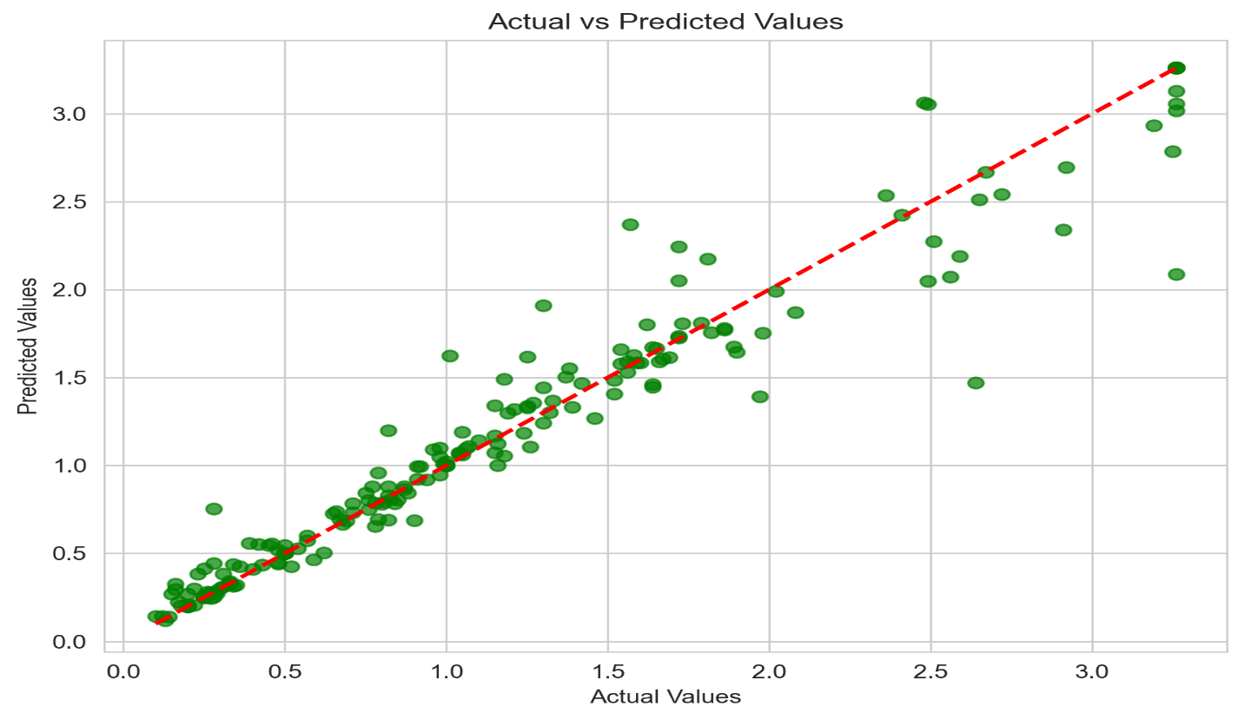
Using Python
This is my Final Regression plot for my data with Specified Changes(removed values from area & production where value was less than 50).
The best fit line covers most of the data points from my data ensuring a good fit model.

Slide 11
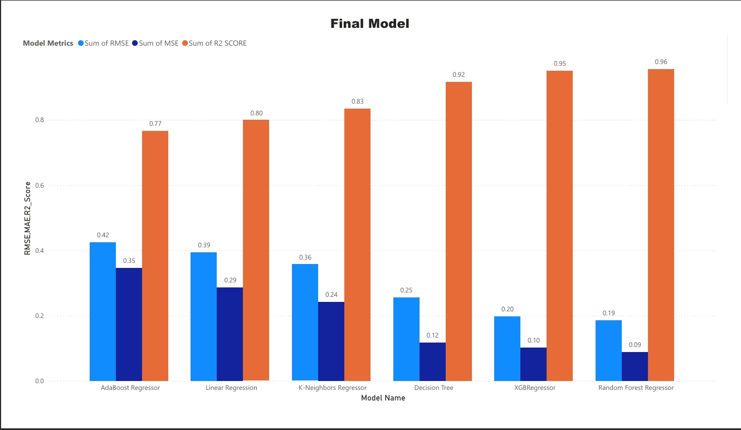
Using Power BI
The plot shows all the models with their respective evaluation metrics like – Mean Squared Error, Mean Absolute Error and R2 Score.
The Random Forest Regressor Algorithm gave me the highest accuracy for my dataset.
The Accuracy given by the Model is – 96%

Slide 12

Future Enhancements
1. Key Focus Areas -
Remote Sensing & IoT – Use satellite imagery and sensor data for real-time crop monitoring.
Climate Resilience – Incorporate climate change scenarios for robust predictions.
Advanced Models – Explore hybrid deep learning (LSTM, CNN, Transformers) for higher accuracy.
Soil & Nutrient Profiling – Add fertility and nutrient data for crop-specific forecasts.
Decision Support System – Build farmer-friendly mobile/web tools for yield guidance.
2. Additional Directions -
Apply Explainable AI (XAI) for transparency & adoption.
Scale across regions and multiple crops.
Enable continuous learning with new data.
Link forecasts with policy & market insights.

Slide 13
Conclusion
The project successfully demonstrated the use of machine learning techniques to accurately predict crop yield.
Random Forest Regressor was identified as the most effective algorithm due to its high accuracy and interpretability. Key takeaways include:
Proper data preprocessing helped in gaining high accuracy, removed sugarcane records from the data, as the area and production were significantly high compared to other crops.
Built the final model by keeping sugarcane records, but kept on values greater than 50 in area and production features, which resulted in a high accuracy of 95%.
Features such as crop, season, area, and production were the most influential in determining crop yield.
Also checked the Model performance on different use case scenarios like removing and capping outliers or just keeping the records for the kharif and rabi season.

Slide 14


